Slide 1
Welcome to NAAC Peer
Team Members
Dr. A.P.J Abdul Kalam Career Development Centre
K K Wagh Institute of Engineering Education and Research, Panchavati, Nashik

Slide 2
Vision and Mission of T&P Cell
Vision | Empowering the students through proper training and career opportunities
Mission | M1: To groom the students meticulously throughout their course for campus interviews and for various career opportunities
 | M2: To provide placement opportunities to maximum students
 | M3: To provide industries a platform for getting the skilled manpower
 | M4: To enhance Industry - Institute interaction for the mutual benefits
Notes:
In aligning with College Vision and Mission

Slide 3
Objectives
To become an effective link between the job seekers and job providers by building up networking with Industries and Alumni.
To ensure transparency and clarity in the Training and Placement Activities
To enhance the employability skills of students
To ensure sustainable employment for all students

Slide 4
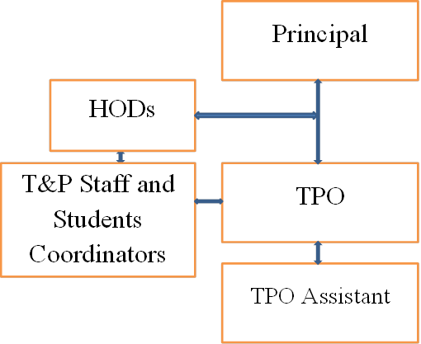
Organisation Chart

Slide 5
T&P Staff Coordinators
Name Of Staff | Department
Vilas Patil | Civil
Suhas Pandit
Vaishali Lele | E&TC
Shilpa Mene | IT
Neha Sharma | Computer
Rutuja Jadhav
Nikhil Bhujbal | Electronics
Amol Sonawane | Production
Name Of Staff | Department
Vijay N Mawal | Chemical
Sonali Akolkar | Electrical
Omkar Buwa
Manoj Sonawane | Mechanical
Praveen Surwade
Saurabh Ambewadikar | MBA
Roshan Gangurde | MCA

Slide 6
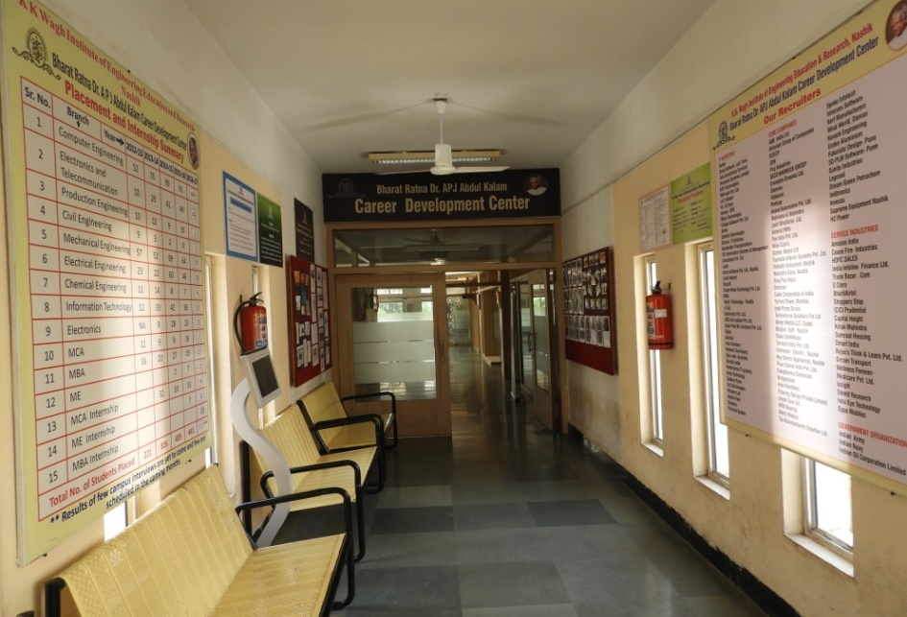
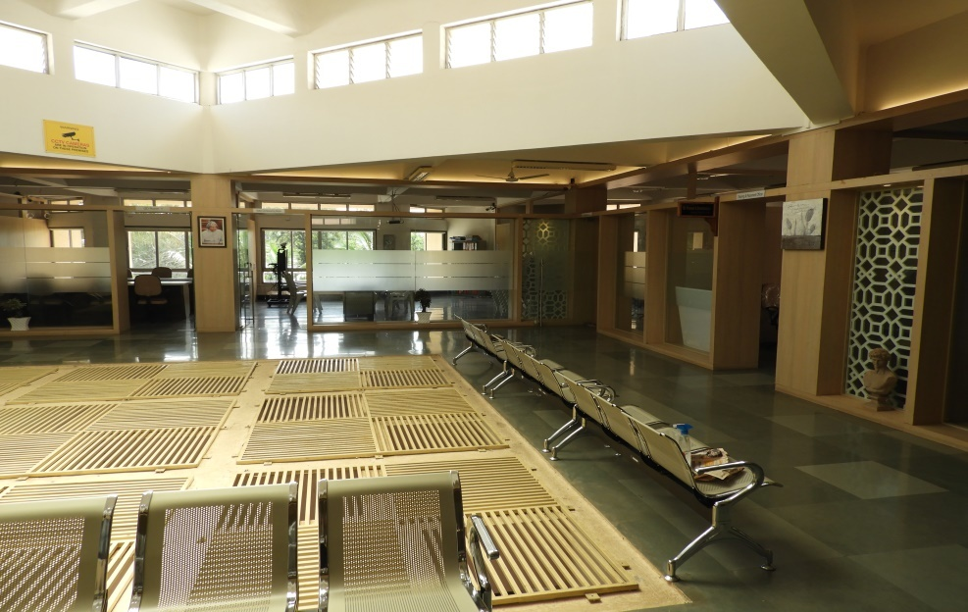
Infrastructural Facilities
Built up area of 5078 Sq ft
2 Computer Labs with 80 Computers
Video Conferencing Facility
High speed Internet with speed 240 Mbps and Wi-Fi connectivity
2 Group Discussion Rooms
3 Personnel Interview Rooms
Separate Pantry
Both Gender Washrooms

Slide 7
Activities
Training of Students
Placement Activities
Students Mentoring
Recruiters’ Feedback
Reaching out to Industries
Entrepreneurship Development Activities
Study Abroad Activities
Service to Alumni
Institute’s Social Responsibility
Students Counseling Facility
Earn and Learn Scheme

Slide 8
Training Policy

Slide 9
Trainings flow from First to Final Year Engineering
Class | Name of The Programme | Out come
FE | TPO connect and Expert Seminars/Workshops | Students are made aware about: Training and Placement Cell and its activities, Details of the visiting companies and their Eligibility Criteria Importance of Academic Marks/Percentage
SE | “Team Building and Motivational” Workshops | Students are trained for public speaking, group activity and SWOC Analysis
TE | Structured Training Programs(60 to 70 Hours) | Training the students for Aptitude Test and Soft Skills
 | HR Connect | Making students aware about industry expectations
BE | Company Specific Training | Preparing Students for Placements
 | Programming skills Post selection training | Making students industry ready

Slide 10
Placement Policy

Slide 11
Placement Activities
Campus Interview begins in the Month of August of an every academic year and continues up to 18 months for each batch.
Placement Policy
One student one Job
Dream Company opportunity to students
Another opportunity, if the package difference is more than 3 lacs per year

Slide 12
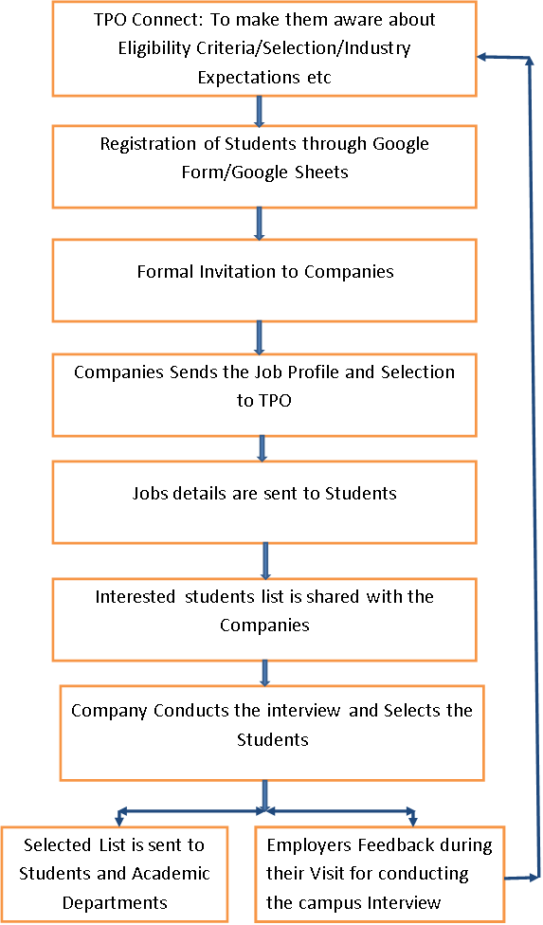
SOP: Placement Activities

Slide 13
Students Mentoring and Feedback System

Slide 14
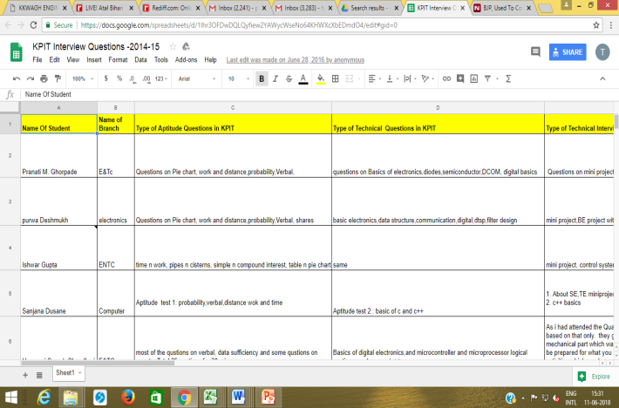
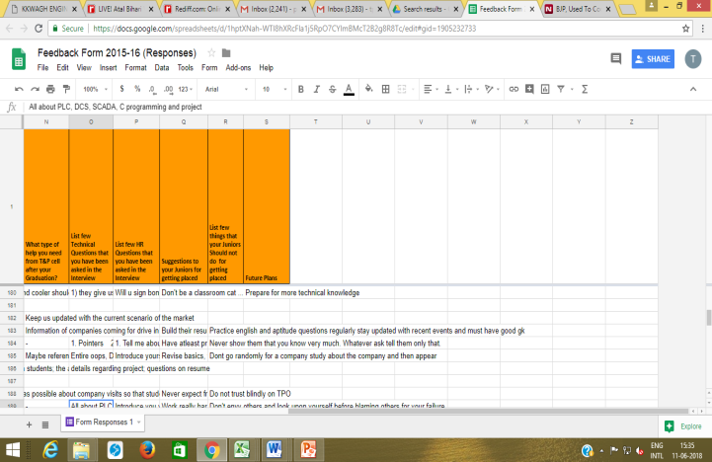
Students Mentoring through Placed Students
After the campus interview Google form is created and sent to students for filling
The objective of this feedback is to know: Technical questions/HR, Questions/Suggestion/Dos and Don'ts to Juniors for Getting the Job through campus Interview
These inputs are shared with the students through TPO Connect and also through email for the preparation
Sample of Google Sheet

Slide 15
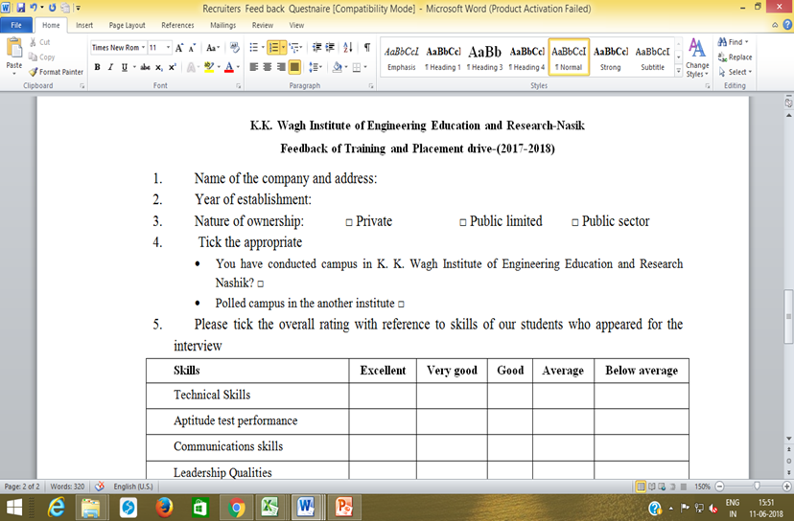
Recruiter Feedback
Feedback is taken from the Recruiter after the campus interview
The objective of this feedback is to:
know the present skill sets of the students
Satisfactory level of the facilities extended by the T&P Cell.
Know open ended suggestions
Sample Feedback Form

Slide 16
T&P Policy

